Slide 1

BlockWager
The Future of Decentralized Betting is Here
Image source: Pexels.com

Slide 2

01 | Intro and Overview
02 | Live Demo
03 | Ethereum Smart Contracts
04 | Challenges Faced
05 | Future Developments and Next Steps

Slide 3
Intro and Overview

Slide 4
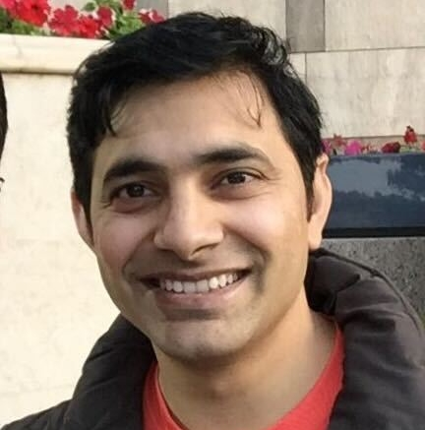






BlockWager - Intro and Overview
Who we are
We are a group of professionals passionate about technology, the world of sports, and aiming to fill a gap in the sports betting market.
Team
Technologies Used
FinTech
Pravin Patil | Stratis Gavnoudias | Will Conyea
Esteban Lopez | Liset Lopez | William Wolfenbarger
What we do
Our product is a user-friendly platform that leverages the security and transparency of blockchain and use of smart contracts.
Odds Scraping
Gambling Economics
Web3 and Blockchain
Smart Contracts
Tokenization
How we do it
We execute on a strategy that user-friendly platform that combines the power of blockchain, smart contracts, and python.
Coding Languages
Python
Solidity
Streamlit/CSS
SQL
GitHub: @prpercy/BlockWager

Slide 5
Live Demo

Slide 6
Live Demo – full list of technologies and packages used
Languages | Python, CSS, Solidity, SQL
User Interface | Streamlit, streamlit_elements, colorama, emojis
Odds-Scraping | sbrscrape, requests, SQLalchemy
Smart Contracts | Remix
Blockchain | Ganache, tokenization, MetaMask
Sports Leagues* | MLB, MLS, NBA, NFL, NHL
Cryptocurrencies | ETH, CBET**
Publishing | GitHub
*Certain sports leagues are planned for future deployment
** Internally developed token, not traded in any public exchanges

Slide 7
Live Demo – technologies and packages used
Strategy
Sneak-peak
XXXXXXX
XXXXXXX
XXXXXXX
[Screenshots/Visuals]
Technologies
XXXXX
XXXXX
XXXXX

Slide 8
Ethereum Smart Contracts

Slide 9
BlockWager – Ethereum Smart Contracts
Strategy
Overview
XXXXXXX
XXXXXXX
XXXXXXX
[Screenshots/Visuals]
Technologies
Remix
Solidity
XXXXX

Slide 10
Challenges Faced

Slide 11
BlockWager – Challenges Faced
Challenges
Sneak-peak
Horse betting odds are difficult to scrape
Implementing ERC20 to mint tokens caused overflow errors and would not compile
MetaMask integration
[Screenshots/Visuals]
Technologies
XXXXX
XXXXX
XXXXX

Slide 12
Future Developments and Next Steps

Slide 13
BlockWager – Future Developments and Next Steps
Sneak Peak
Next Steps
Fully decentralized betting
Access to all major US sports leagues
Machine learning betting suggestions and sentiment tracking
Analytics and statistics
Cloud deployment
[Screenshots/Visuals]

Slide 14
BlockWager
Feeling lucky?
Image source: Pexels.com

